Slide 1

VIDEO TO AUDIO CONVERTER
TEAM MEMBERS:
2010030180 ABHIRAM. V
2010030142 ROKKAM VIVEK VARDHAN REDDY
2010030443 SIDHARTH RAO. K
2010030394 RAGHAVENDRA GOUD. A

Slide 2
ABSTRACT:
The project video to audio converter is all about converting a mp4 file to mp3 file.
We will need a video recording for this project. It can even be a recording of yourself speaking to the camera.
Using a library called MoviePy, we will extract the audio from the video recording.
We need to give the input as video and we get output as audio.

Slide 3
INTRODUCTION:
Converting Video to audio files is a smart tool to extract audio from video files.
We will take you through a simple program to build a video to audio converter with Python programming language.
It is used to extract audio from the a desired video where in we are just interested in just audio.

Slide 4
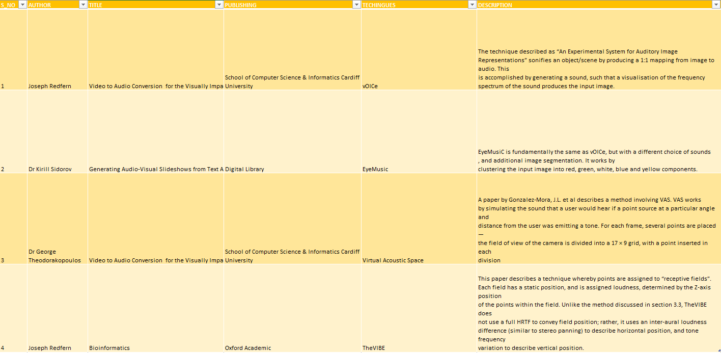
LITERATURE REVIEW:

Slide 5
METHODS:
1.MoviePy is a library that can read and write all the most common audio and video formats.
pip install SpeechRecognition moviepy
Here are some video formats:
MP4 (mp4, m4a, m4v, f4v, f4a, m4b, m4r, f4b, mov)
3GP (3gp, 3gp2, 3g2, 3gpp, 3gpp2)
OGG (ogg, oga, ogv, ogx)
WMV (wmv, wma, asf*)

Slide 6
Here are some audio formats:
MP3
AAC
WMA
AC3 (Dolby Digital)

Slide 7
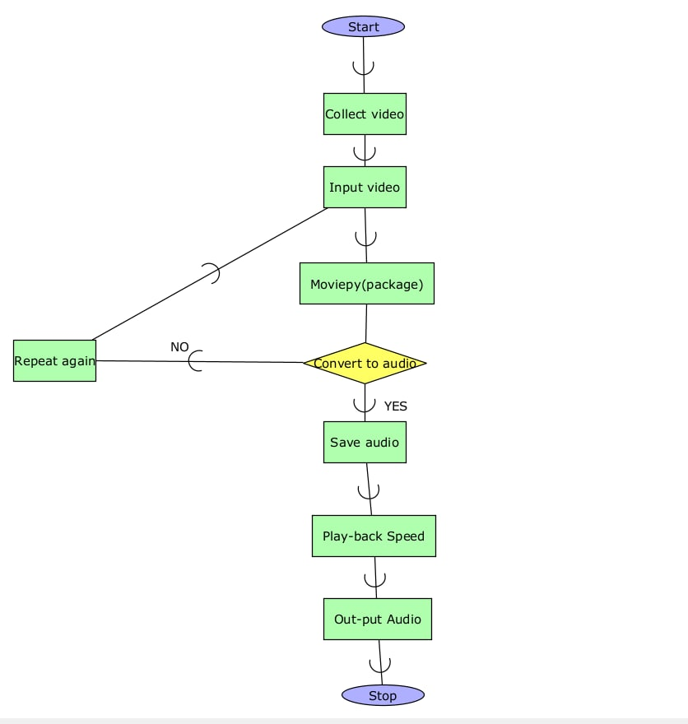
FLOWCHART

Slide 8
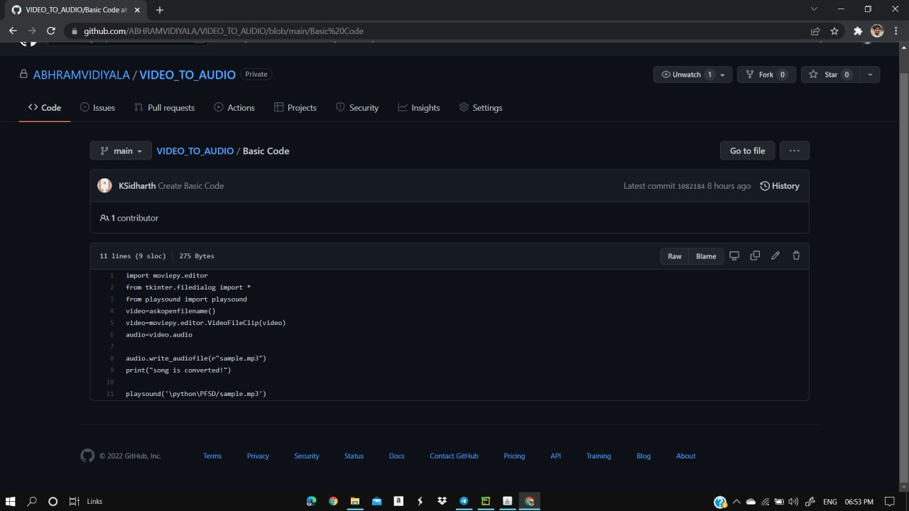
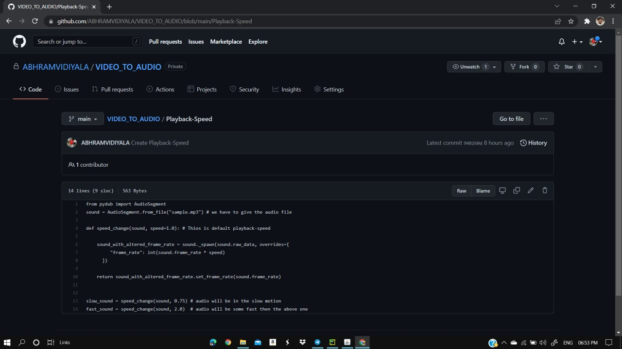
GITHUB COMMITS

Slide 9
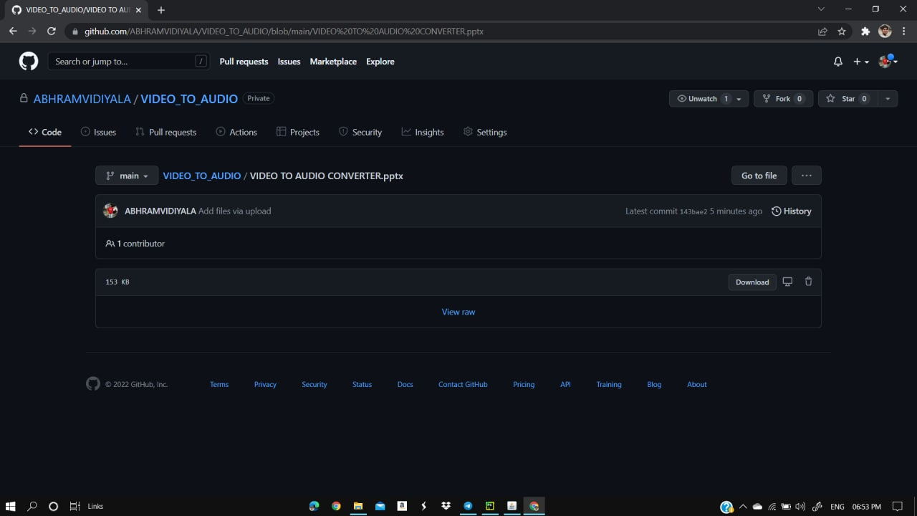
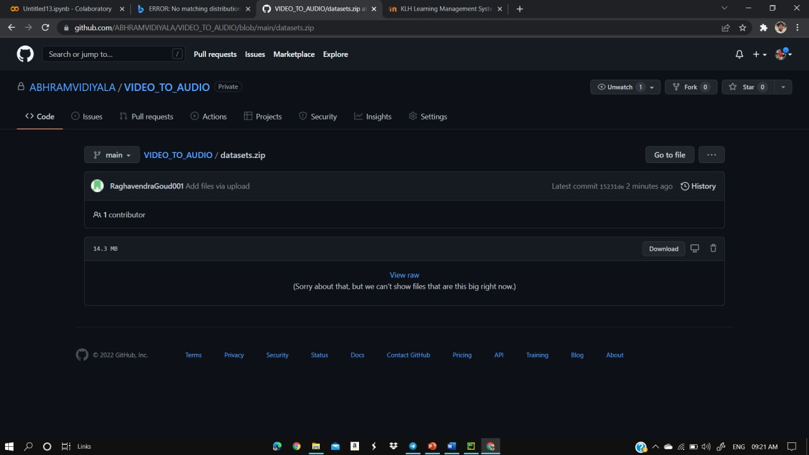

Slide 10
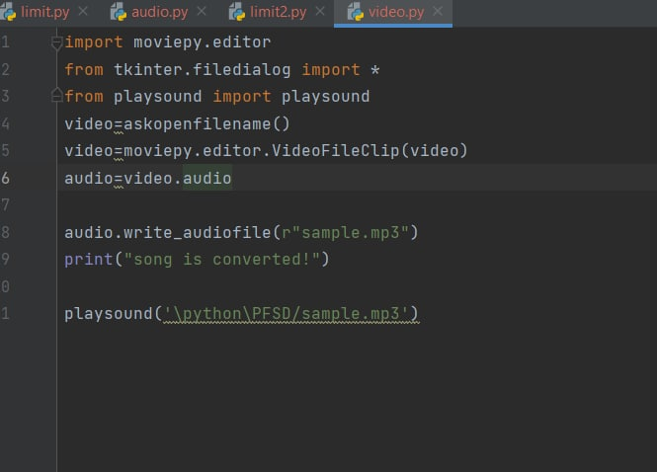
WORK IN PROGRESS

Slide 11
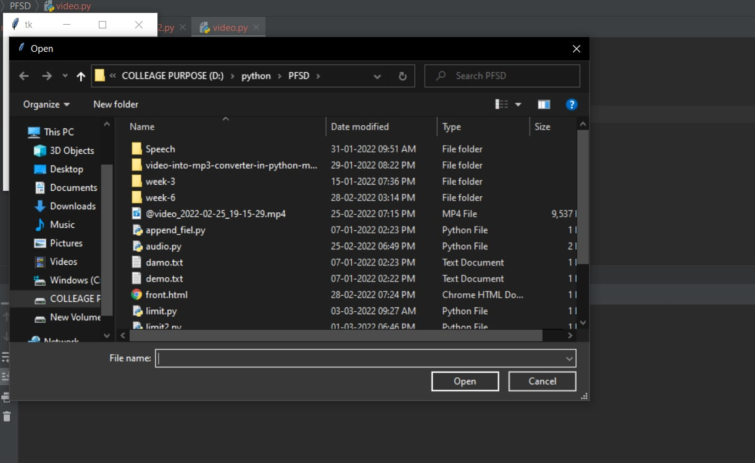

Slide 12
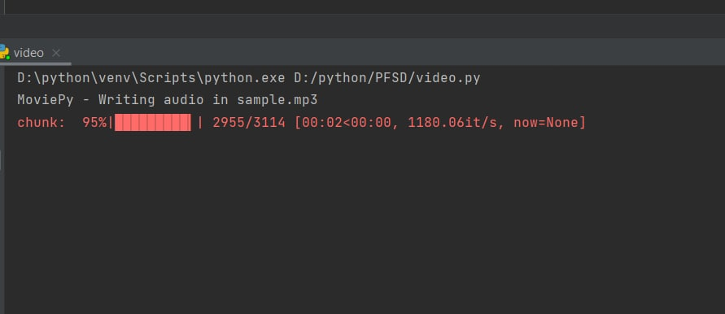

Slide 13
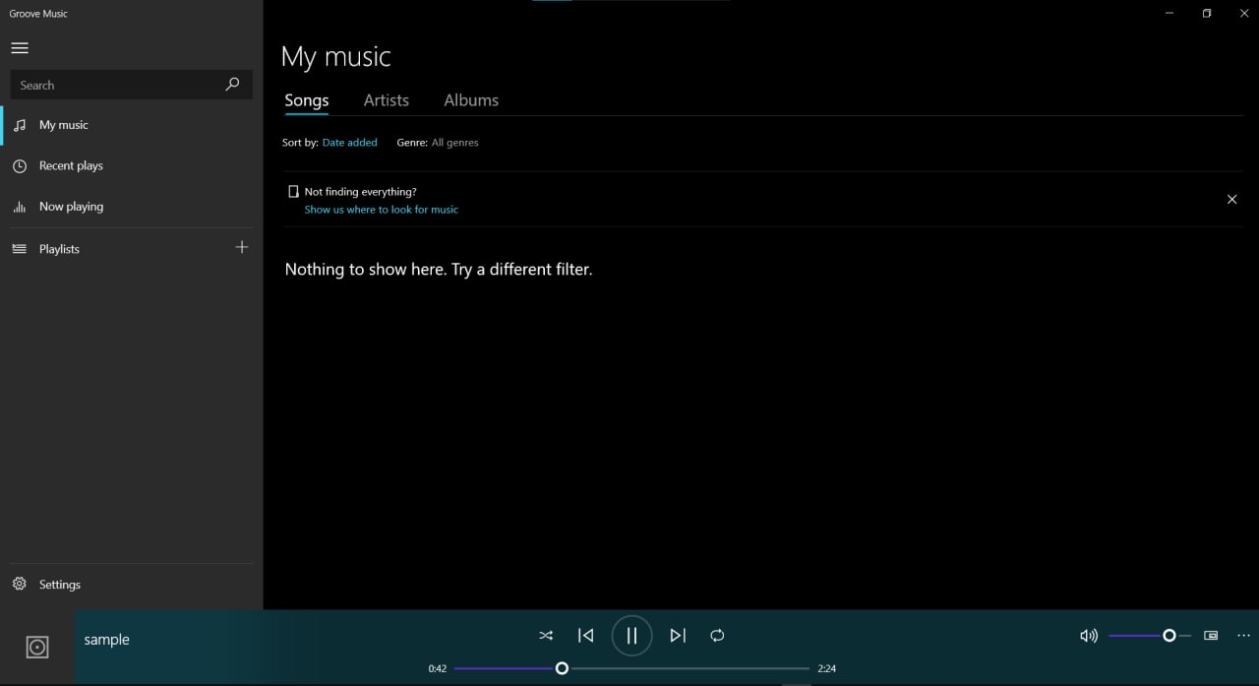

Slide 14
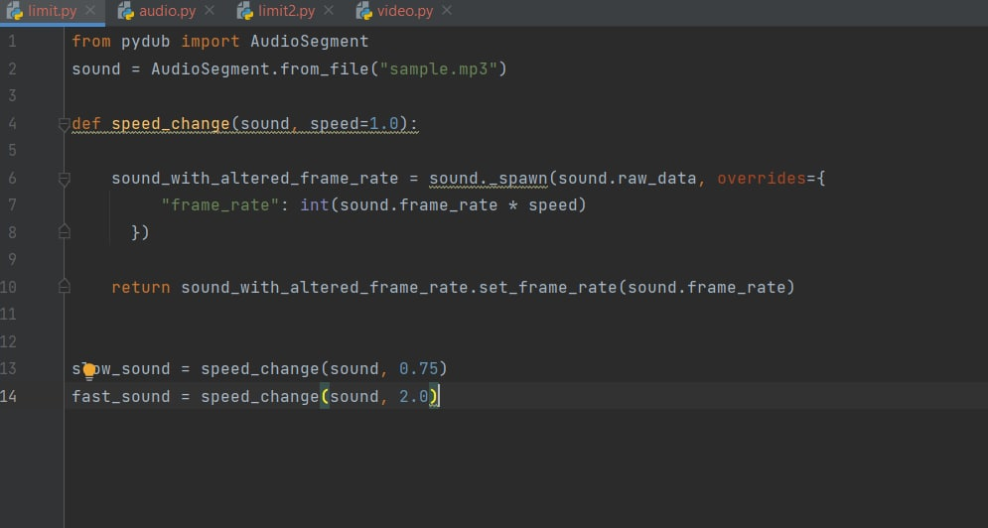
ALPHA TESTING

Slide 15
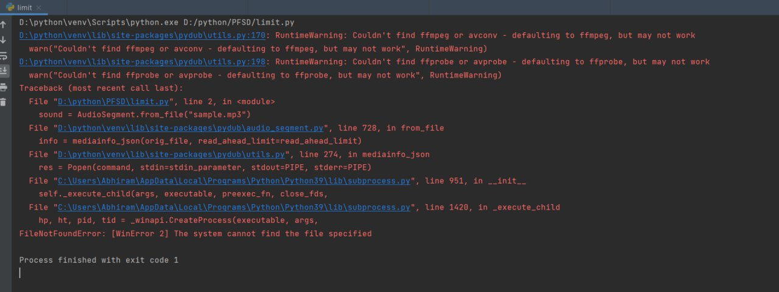

Slide 16
RESULT:
Thus, by following the above technique, we can convert a mp4 file into an mp3 file.
In the cases where we will need only the audio in the video files, we can use this technique to extract and save the audio file, which will help in saving the memory too.
We have developed a code for controlling the speed of the output speech, which will make it easy for people to understand.
Here, the user will have the comfort of selecting his desired vedio, and can convert it into audio form.

Slide 17
CONCLUSION:
Converting a video to audio has many advantages and is very useful in our amateur learning. The above-mentioned technique can be used in achieving this.
But when you want to convert some videos containing sensitive information, desktop applications that can work without a network would be a better choice.
It will not upload your videos to its service and change the file format by offline transcoding.

Slide 18
thankyou

